Slide 1
CS Club First Meeting
9-20-20
Welcome!

Slide 2
Tonight’s Agenda
Officer Introductions
Git crash course
Open discussion!

Slide 3

Will Estony (he/him/his) - President
Grade: Senior
From: Dutchess County, NY
Major: CS
Minor: English
CS Interests: Docker, Django in Python, Making 2D Games
Non-CS Interests: Running, Tennis, Golf, Reading/Writing
Interesting Fact: I studied abroad in the spring!

Slide 4

Digesh Chitrakar - Co-Treasurer
Grade: Junior
Where I’m from: Nepal
Major: Computer Engineering and Mathematics
Interests: Robotics App Development Drawing
Interesting fact: I can understand 5 languages

Slide 5

Edwin Aldrich - Co-Treasurer
Grade: Senior
Major: Computer Engineering and Computer Science
Interests: 3D Printing, IOT Automation, Food, Gaming
Where I’m from: Cleveland, Ohio
Interesting fact: I walked 70k steps in one day last semester.

Slide 6
What is git?
Version control system
Came out in 2005
Popular in both commercial software and the open source world
Command-Line tool
If you don’t use it, you will lose it :(

Slide 7
What is github?
A place where developers can store their projects in a repository (repo)
Repos can be public or private
Many developers can work on a single repo.

Slide 8
What you need to do this exercise:
A github account (it’s free). Go to www.github.com to make one.
Git CLI downloaded on your computer (see next slide)
Terminal for Mac, Cmd or Command Prompt on Windows
Some sort of text editor, can be as simple as notepad or textedit, or as fancy as VSCode

Slide 9
Installing git on Mac
Open the terminal and type git --version

Slide 10
Installing git on Windows
Go to the following link https://git-scm.com/download/win and the download should start automatically.

Slide 11
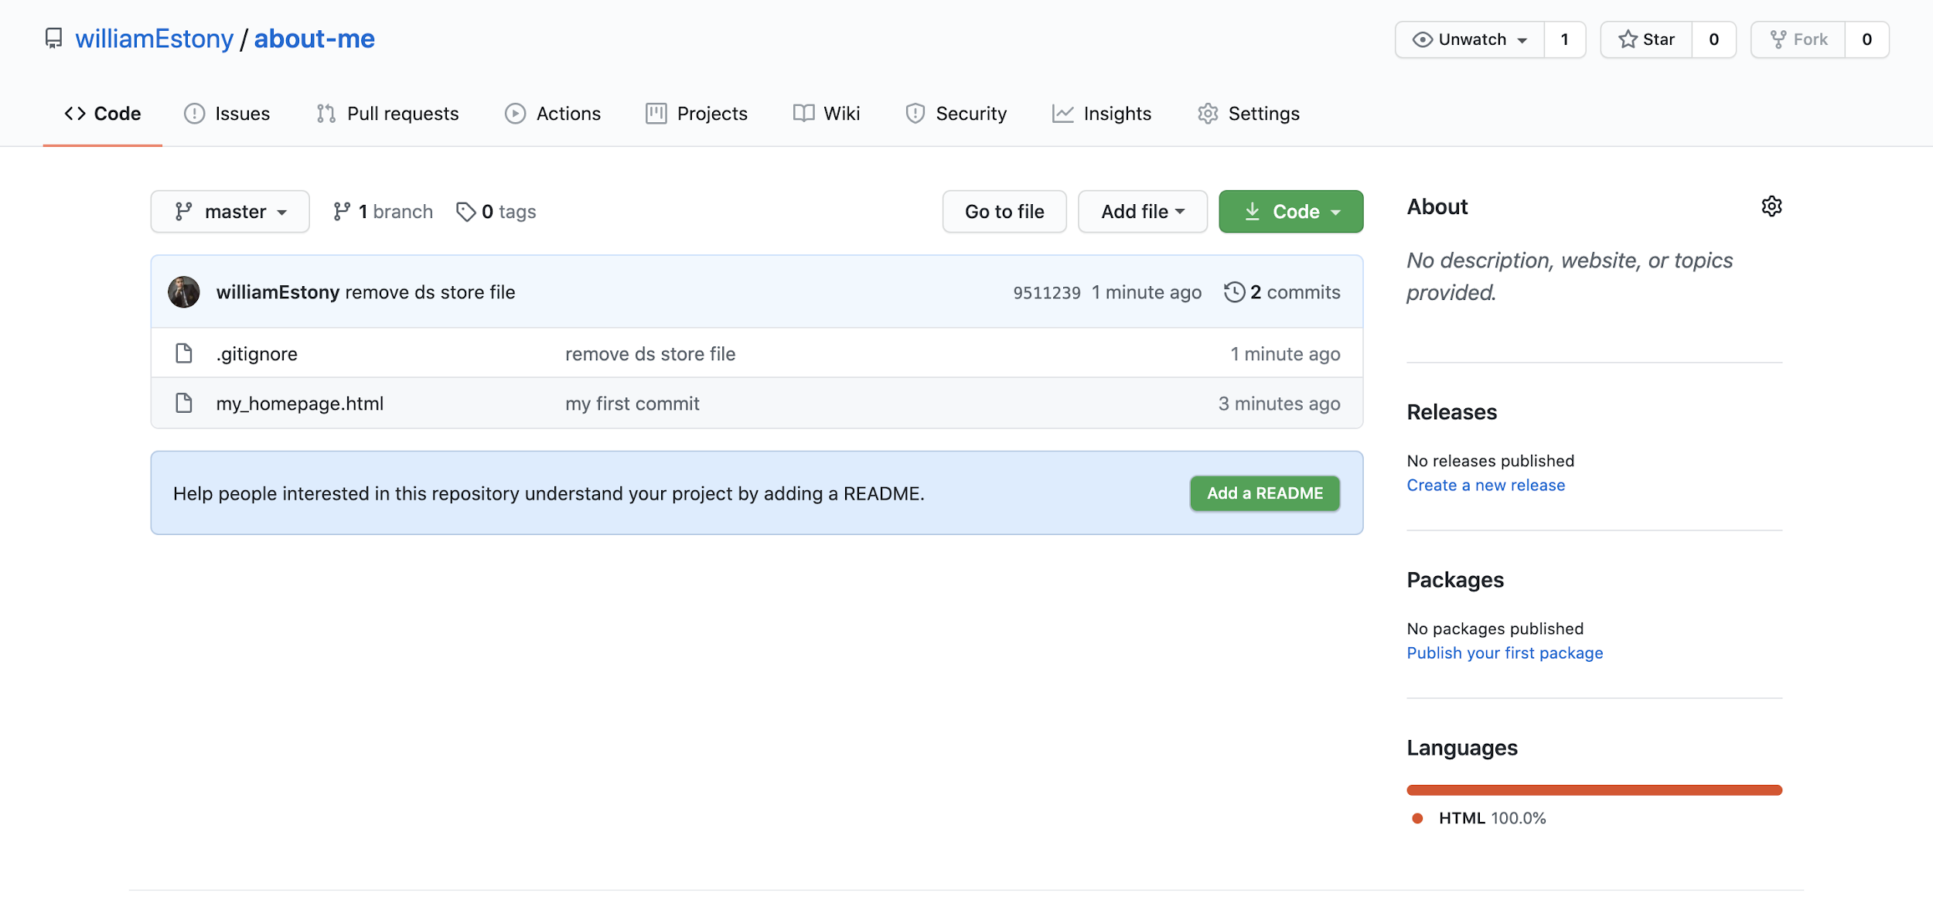
Fork your first repo
Go to https://github.com/williamEstony/cs_club and click “fork” in the top right corner of the screen.

Slide 12
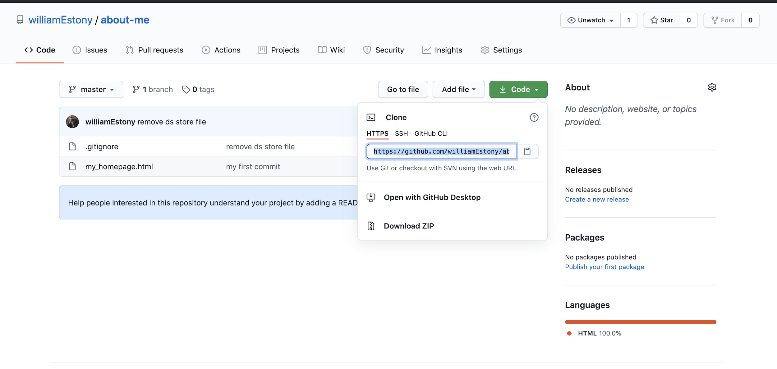
Clone your first repo
Make sure you clone using HTTPS, not SSH or GitHub-CLI!

Slide 13
Clone your first repo
Cloning a repo is done on the command line and gets the project files from github onto your local machine.
Open up Cmd or Terminal
Change to your desired directory (folder)
For example - cd Documents/CS-Club
Once you are at your desired directory on the command line type:
git clone [the url you copied from github]
This should create a new folder called about-me with one document in it - my_homepage.html
cd into this directory

Slide 14
Now we can actually make some changes using git!
By typing the following git commands you will get various results:
git - dumps out a list of possible git commands onto the terminal
git status - tells you what branch you are on, and if you’ve made any changes that need to be committed
git add - allows you to pick and choose which changes to the project you want to add
Often if you want to add everything you can just do - git add .
git commit - records the changes you’ve made in the repository. There is a message associated with this command like “fixed off by one error”
git push - last step, actually gets your changes in the repo!

Slide 15
Update my_homepage.html
You don’t need to know any actual html to do this. All you have to do is replace the bits of text that are about Will, to information about you!
When you are done, add, commit and push your changes to github!

